Slide 1

Modeling VI

Slide 2
Introduction
Now We Consider
Categorical Response Variables
Numerical/Categorical Explanatory Variables
Focus is on Classification
Bless Your Soul with Ch 4 in ISLR

Slide 3
Introduction
Basic Case: Binary Response
Variable Has Two Possible Outcomes
Typically, Yes or No Responses to a Question
Example
Y = Do You Enjoy Your Experience in the Presence of the Doctor?
Y = Did You Pass Your STOR 320 Class?
Y = Are You Comfortable Having Your Mind Blown?

Slide 4
Scenario
Question: Are Students Who Get Good Grades in STOR 320 Less Likely to Recommend This Class To an Enemy?
Y = Would You Recommend STOR 320 to an Enemy?
X = Grade in STOR 320
Why is Linear Regression Inappropriate?

Slide 5
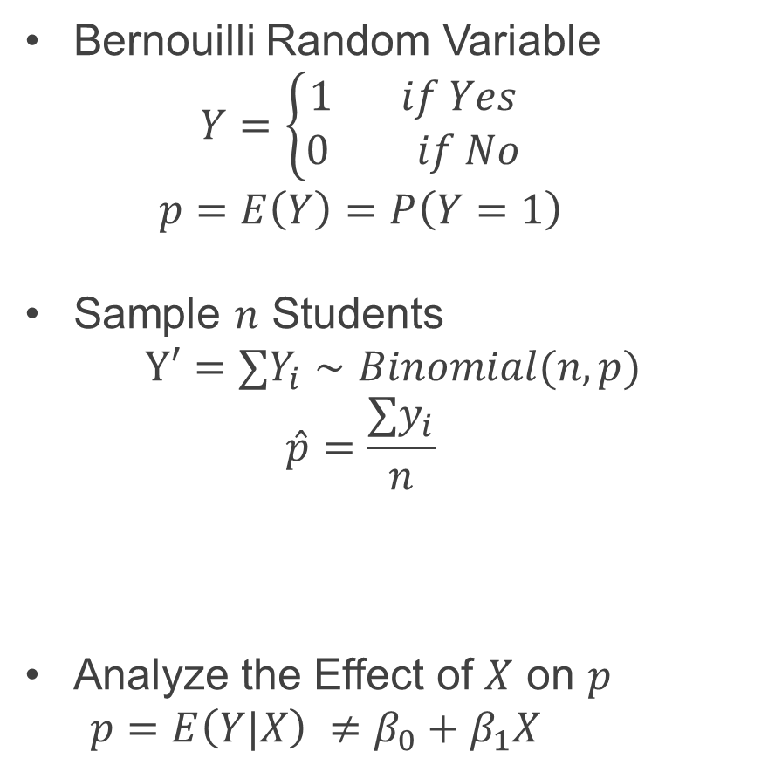
Model Construction
Bernouilli Random Variable
$$Y=\left\{\begin{aligned}1 if Yes \\ 0 if No\end{aligned}\right.$$
$$p=E\left(Y\right)=P\left(Y=1\right)$$
Sample $n$ Students
$$Y′=∑Y_{i}∼Binomial(n,p)$$
$$\hat{p}=\frac{∑y_{i}}{n}$$
Analyze the Effect of $X$ on $p$
$p=E\left(Y|X\right) ≠$ $β_{0}+β_{1}X$
Estimated Probability that a Student Would Recommend Class to an Enemy Based on a Sample

Slide 6
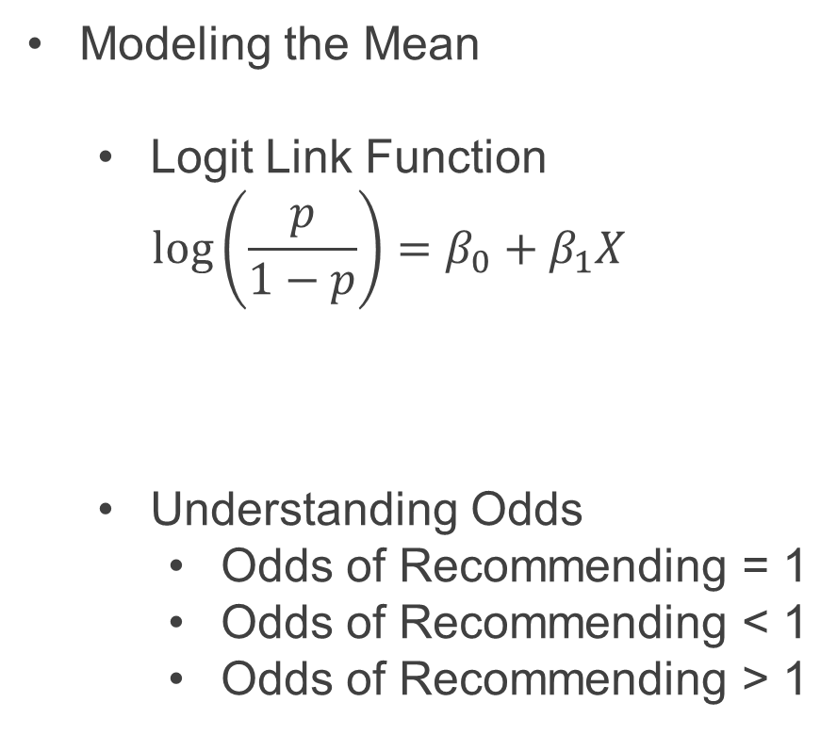
Model Construction
Modeling the Mean
Logit Link Function
$$\log\left(\frac{p}{1−p}\right)=β_{0}+β_{1}X$$
Understanding Odds
Odds of Recommending = 1
Odds of Recommending < 1
Odds of Recommending > 1
Odds of Recommending
STOR 320

Slide 7
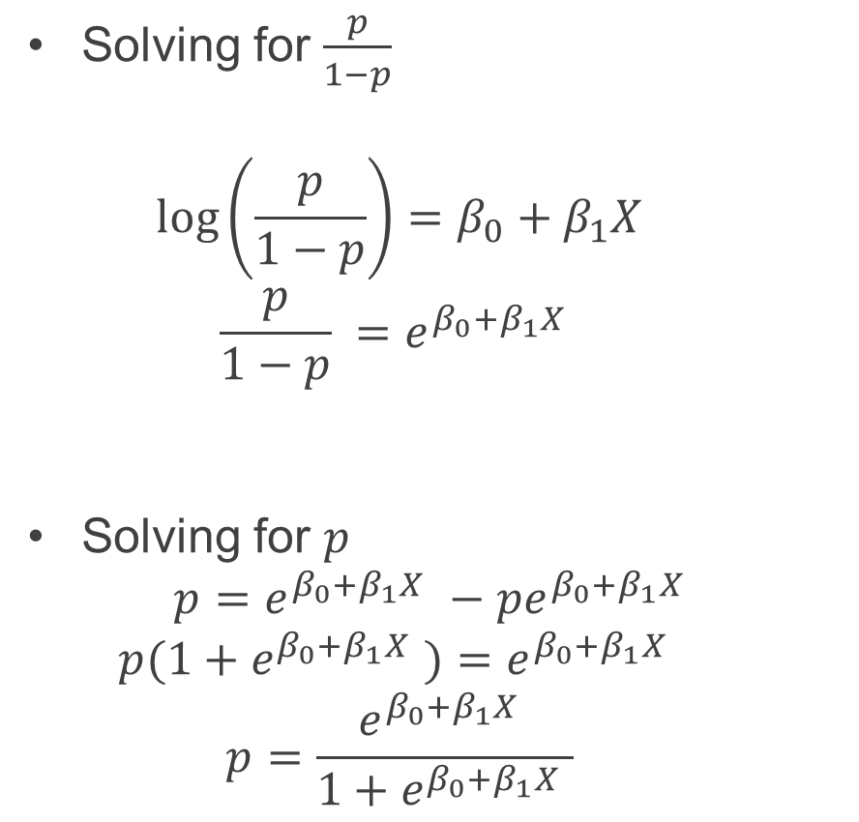
Model Construction
Solving for $\frac{p}{1−p}$
$$\log\left(\frac{p}{1−p}\right)=β_{0}+β_{1}X$$
$$\frac{p}{1−p} =e^{β_{0}+β_{1}X }$$
Solving for $p$
$$p=e^{β_{0}+β_{1}X }−pe^{β_{0}+β_{1}X }$$
$$p{(1+e}^{β_{0}+β_{1}X })=e^{β_{0}+β_{1}X }$$
$$p=\frac{e^{β_{0}+β_{1}X }}{{1+e}^{β_{0}+β_{1}X }}$$
Odds of Recommending STOR 320 Given the Student’s Grade
Probability a Student Will Recommend STOR 320 Given the Student’s Grade

Slide 8
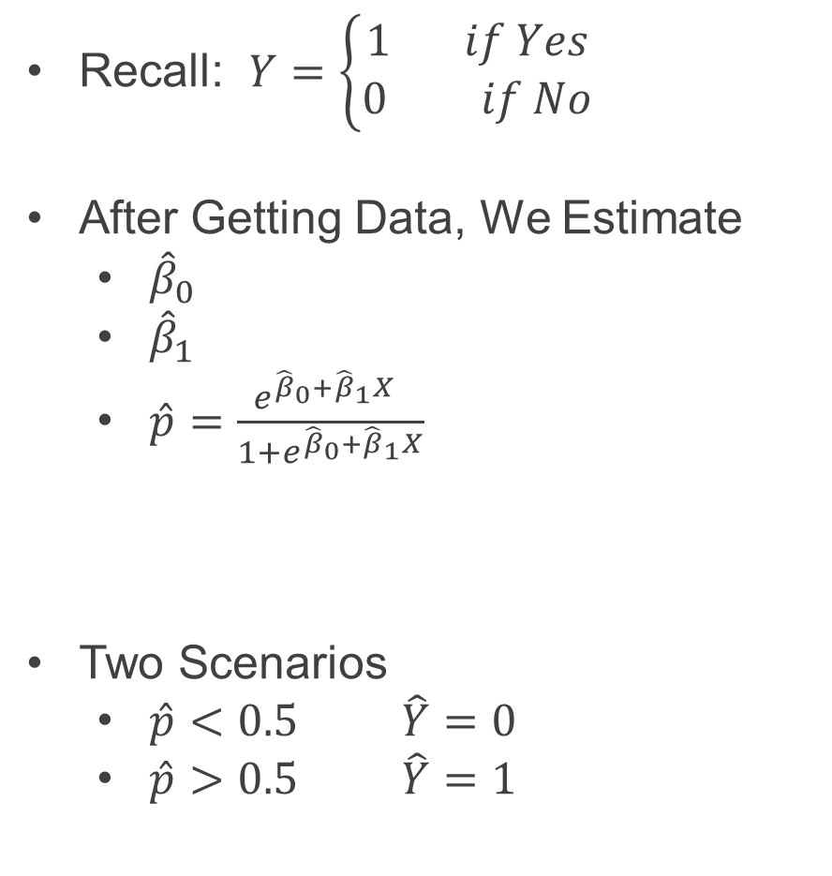
Logistic Regression for Classification
Recall: $Y=\left\{\begin{aligned}1 if Yes \\ 0 if No\end{aligned}\right.$
After Getting Data, We Estimate
${\hat{β}}_{0}$
${\hat{β}}_{1}$
$\hat{p}=\frac{e^{{\hat{β}}_{0}+{\hat{β}}_{1}X }}{{1+e}^{{\hat{β}}_{0}+{\hat{β}}_{1}X}}$
Two Scenarios
$\hat{p}<0.5$ $\hat{Y}=0$
$\hat{p}>0.5$ $\hat{Y}=1$
Estimated Probability a Student Recommends Course Given the Student’s Grade

Slide 9
Evaluating the Logistic Regression Model
Two Methods
Leave Out Data Intentionally
Use Cross-Validation
Positives and Negatives
True Positive = Predicted a Recommendation and the Student Recommended
False Positive=Predicted a Recommendation and the Student Didn’t Recommend
False Negative = Predicted a Student Wouldn’t Recommend and They Did Recommend
True Negative = Predicted a Student Wouldn’t Recommend and They Didn’t Recommend

Slide 10
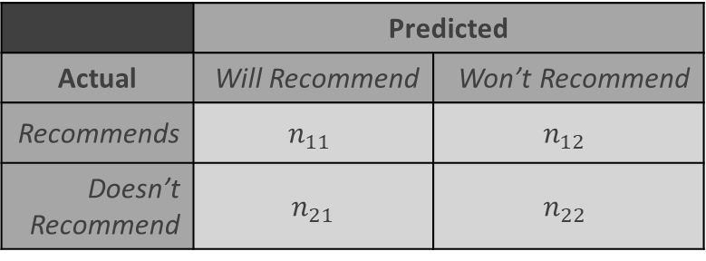
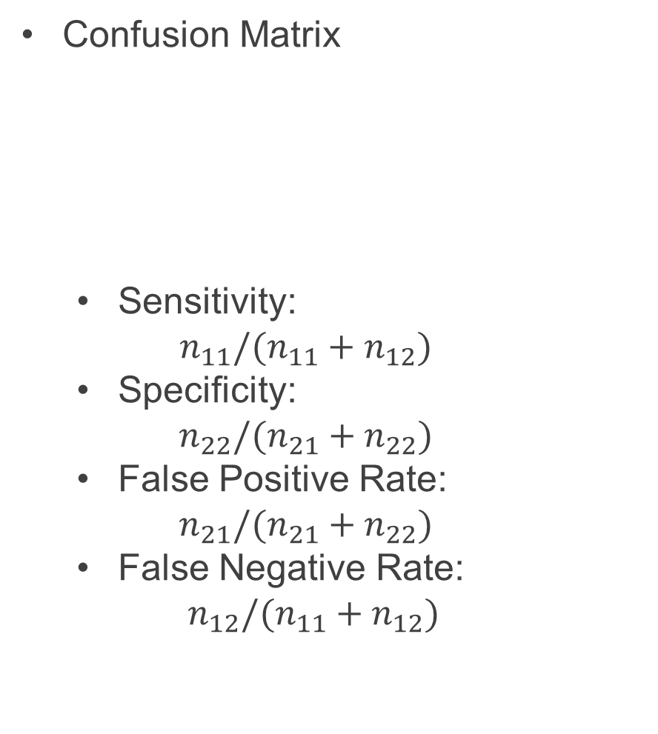
Evaluating the Logistic Regression Model
Confusion Matrix
Sensitivity:
$$n_{11}/(n_{11}+n_{12})$$
Specificity:
$$n_{22}/(n_{21}+n_{22})$$
False Positive Rate:
$$n_{21}/(n_{21}+n_{22})$$
False Negative Rate:
$n_{12}/(n_{11}+n_{12})$
 | Predicted
Actual | Will Recommend | Won’t Recommend
Recommends | $$n_{11}$$ | $$n_{12}$$
Doesn’t Recommend | $$n_{21}$$ | $$n_{22}$$

Slide 11
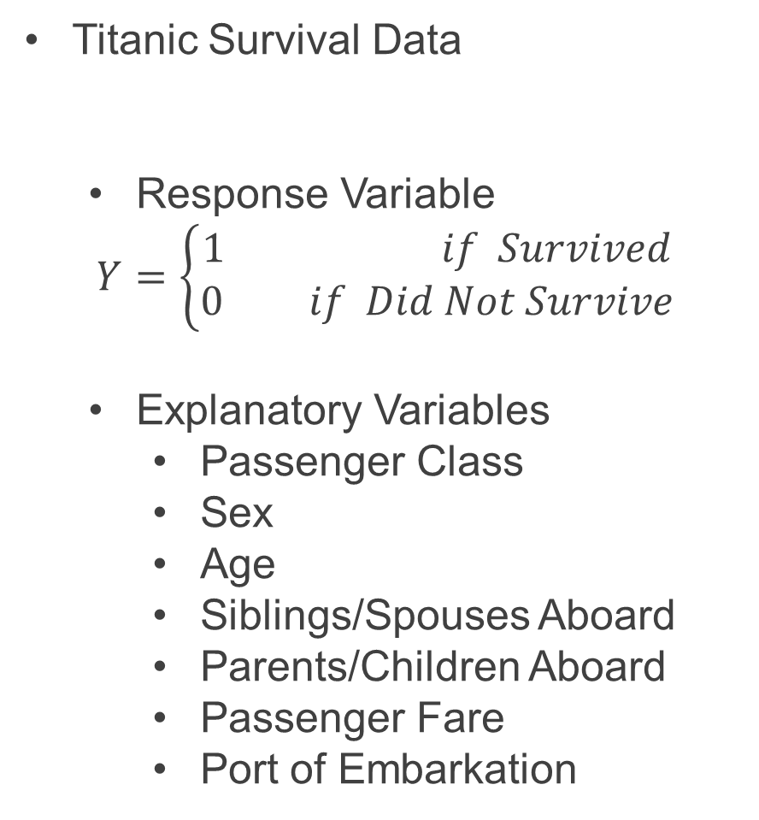
I Won’t Go Down With This Ship
Titanic Survival Data
Response Variable
$$Y=\left\{\begin{aligned}1 if Survived \\ 0 if Did Not Survive\end{aligned}\right.$$
Explanatory Variables
Passenger Class
Sex
Age
Siblings/Spouses Aboard
Parents/Children Aboard
Passenger Fare
Port of Embarkation
> library(titanic)

Slide 12
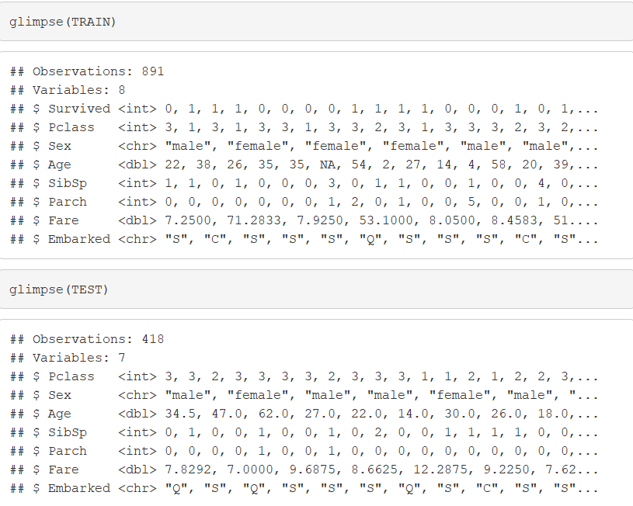
I Won’t Go Down With This Ship
Titanic Survival Data (Continued)
Selecting Variables of Interest
Glimpse of Data
> TRAIN=titanic_train[,c(2,3,5,6,7,8,10,12)]
> TEST=titanic_test[,c(2,4,5,6,7,9,11)])
Problem?

Slide 13
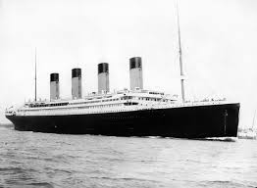
Pause For Lyrics
Every night in my dreams I see you, I feel you That is how I know you go on

Slide 14
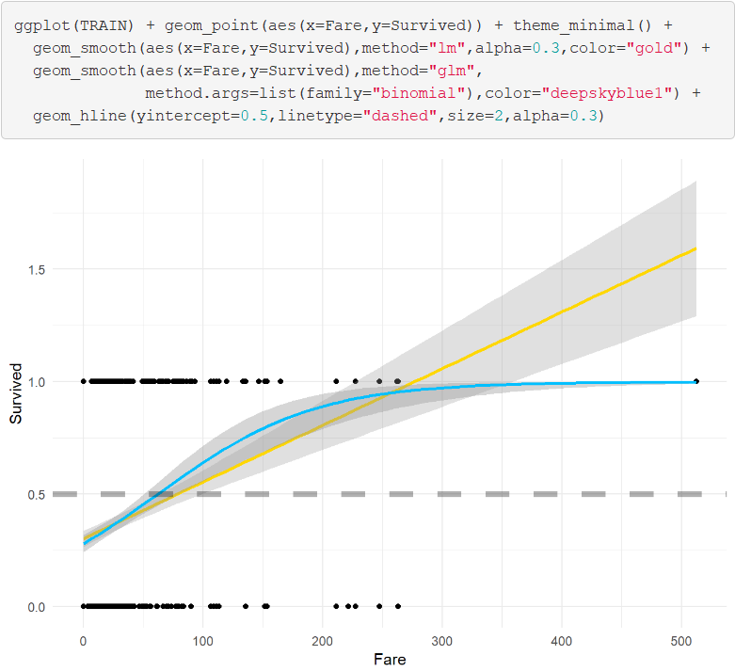
I Won’t Go Down With This Ship
Visualizing the Data

Slide 15
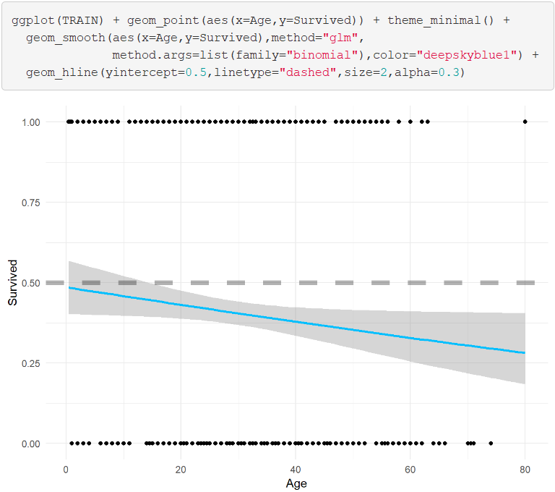
I Won’t Go Down With This Ship
Visualizing the Data (Continued)

Slide 16
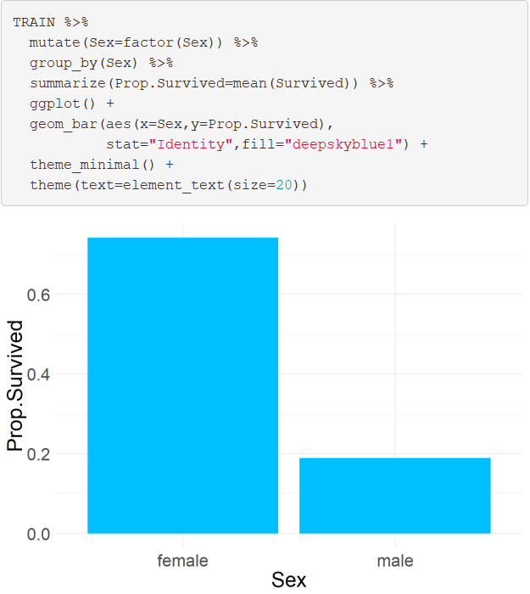
I Won’t Go Down With This Ship
Visualizing the Data (Continued)

Slide 17
Pause For Lyrics
Far across the distance And spaces between us You have come to show you go on

Slide 18
I Won’t Go Down With This Ship
Logistic Regression Models
Split Training Set Up
Modeling the Probability of Survival Given the Ticket Fare, the Sex of the Passenger, and the Age of the Passenger
> set.seed(216)
> sample.in=sample(1:dim(TRAIN)[1],
size=floor(0.8*dim(TRAIN)[1]))
> TRAIN.IN=TRAIN[sample.in,
c("Survived","Fare","Sex","Age")]
> TRAIN.OUT=TRAIN[-sample.in,
c("Survived","Fare","Sex","Age")]

Slide 19
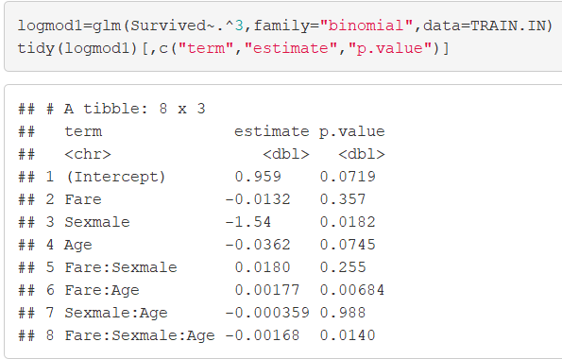
I Won’t Go Down With This Ship
Logistic Regression Models (Cont.)
Including 3-Way Interaction

Slide 20
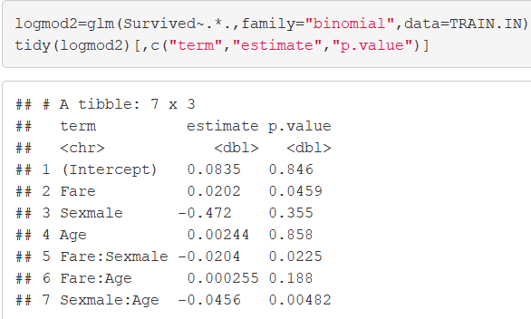
I Won’t Go Down With This Ship
Logistic Regression Models (Cont.)
Only 2-Way Interactions

Slide 21
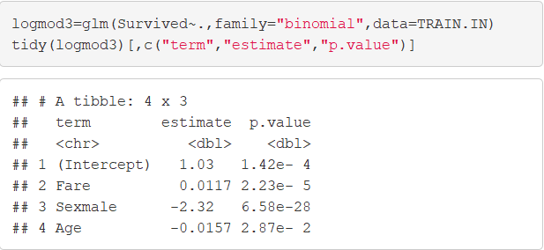
I Won’t Go Down With This Ship
Logistic Regression Models (Cont.)
No Interaction Effects

Slide 22
Pause For Lyrics
Near, far, wherever you are I believe that the heart does go on

Slide 23
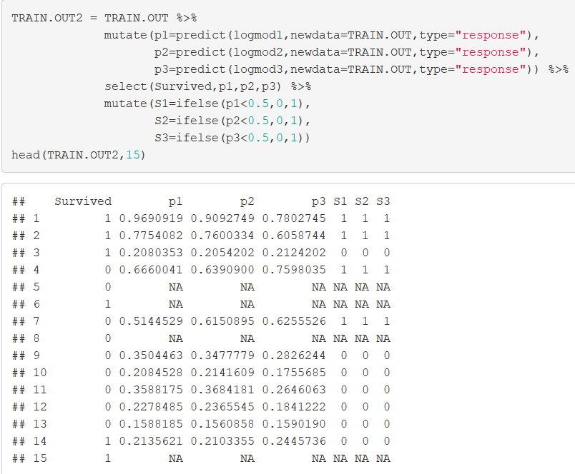
I Won’t Go Down With This Ship
Getting Predictions
Why?

Slide 24
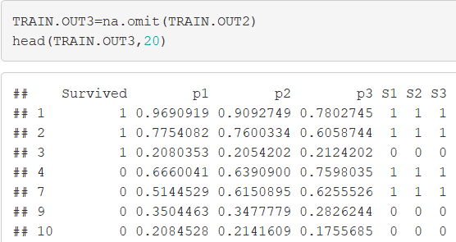
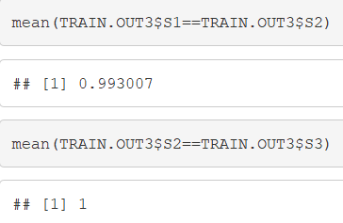
I Won’t Go Down With This Ship
Getting Predictions
What Do You Notice About the Predictions?

Slide 25
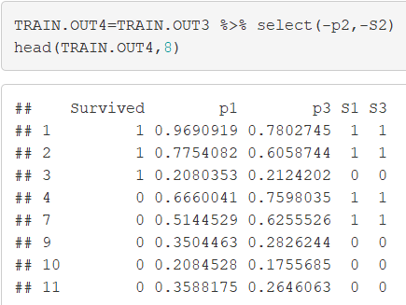
I Won’t Go Down With This Ship
Getting Predictions
Where Do You See Error?

Slide 26
Pause For Lyrics
Once more you open the door And you're here in my heart And my heart will go on and on

Slide 27
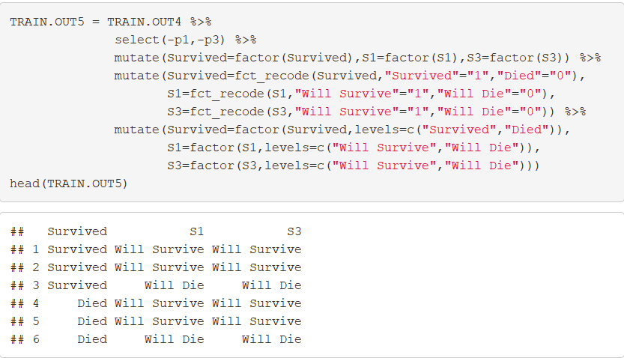
I Won’t Go Down With This Ship
Evaluating Results
Helpful Modifications

Slide 28
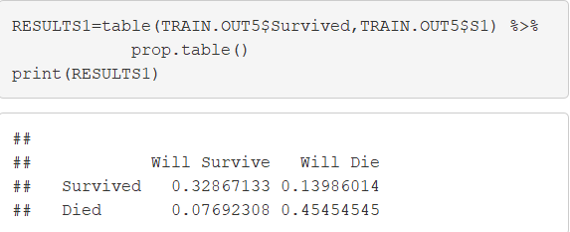
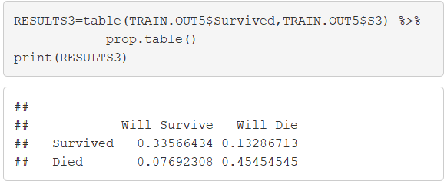
I Won’t Go Down With This Ship
Evaluating Results (Continued)
Confusion Matrix
3-Way Interaction
No Interactions

Slide 29
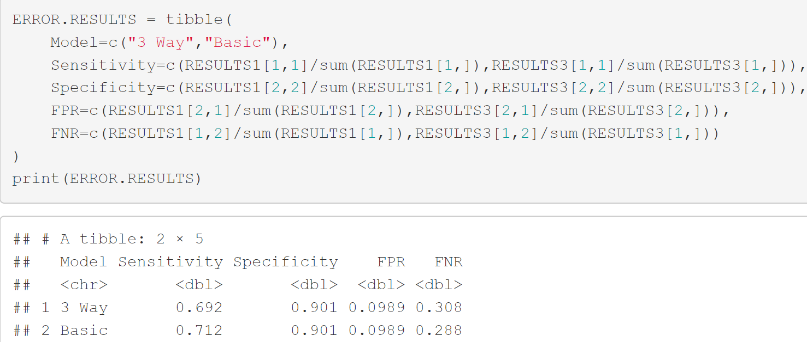
I Won’t Go Down With This Ship
Evaluating Results (Continued)
Error Statistics

Slide 30
Closing
Disperse and Make Reasonable Decisions

